Slide 1


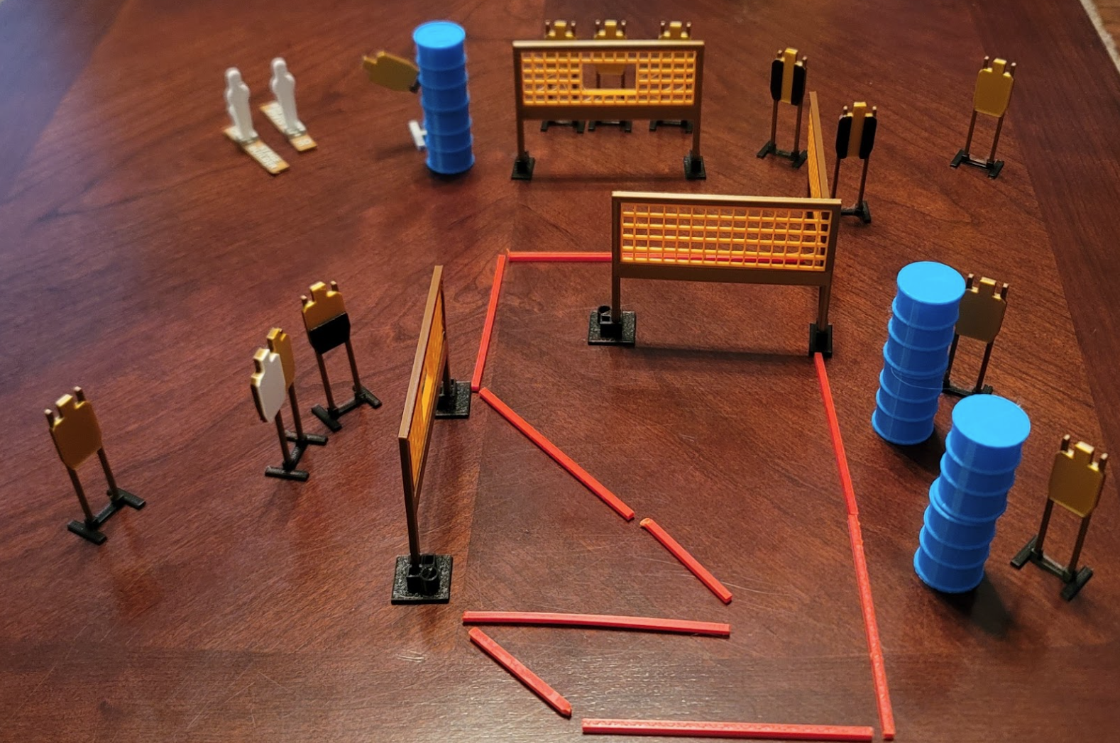
 | Dothan Gun Club – USPSA Match Pacman Course Designer : Eric Henwood Bay: 4
Round Count 26 rounds 12 USPSA 1 mini popper, 1 colt popper
Equipment List 7 wall feet 2 tux, 1 50% 10 targets (9 + 1 NS)

Slide 2
Pacman
Written Stage Briefing
Scoring: Comstock Rounds: 26
Targets: 12 USPSA, 2 steel
Handgun start position: anywhere inside the shooting area, wrists below belt. Handgun is unloaded and holstered.
PCC start position: anywhere inside the shooting area, stock on belt. Unloaded carbine is held with both hands, safety on.
Stage Procedure: on the audible start signal, engage targets as they become available from within the shooting area. The swinger is activated by P2 and remains visible at rest.

